Slide 1
Starter Questions
Q1. Calculate 65% of 570kg
Q2. 8m 11m
Q3. If a = -3 and b = -4 does
a² – 3b² = 57
Q4. Calculate

Slide 2
Example
Find the volume of the composite shape.
7 cm
V_{T} = V₁ + V₂
5 cm
V_{T} = 105 + 720
3 cm
V_{T} = 825 cm³
9 cm
V₁ = l x b x h
= 3 x 5 x 7
= 105 cm³
10 cm
V₂ = l x b x h
= 8 x 10 x 9
8 cm
= 720 cm³

Slide 3
Volume of a Triangular Prism
Working
4cm
Triangle Area =
10cm
= 2 x4 = 8 cm²
4cm
Volume = Area x length
= 8 x 10 = 80cm³

Slide 4
Example
Find the volume of the triangular prism.
Working
Triangle Area =
= 3 x 3 = 9 cm²
Volume = Area x length
= 9 x 30 = 270cm³
3cm
30cm
6cm
Total Area
= 6+6+30+40+50 = 132cm²

Slide 5
Example
Find the volume of
this prism.
Working
Triangle Area =
= 6 x 8 = 48 m²
Rectangle = l x b
= 6 x 12 = 72cm²
8cm
6cm
Total Area = 72 + 48
= 120 m²
15cm
12cm
Volume = Area x length
= 120 x 15 =1800m³
Total Area
= 6+6+30+40+50 = 132cm²

Slide 6
Volume of a Cylinder
Example : Find the volume of the cylinder below.
5cm
V = πr²h
10cm
= π(5)²x10
Cylinder
(circular Prism)
= 250π cm³
= 784.5 cm³

Slide 8
Example
Find the length the cuboid
4 cm
V=200cm³
Volume = L x B x H
5 cm
200 = L x 5 x 4
L
10 cm
This is just an equation.
We know how to solve them !
200 = 20L
20L = 200
L = 10

Slide 9
Volume
Now Try
TJ N5 Lifeskills
Revision Ex
Ch19 (page 173)

Slide 10
Starter Questions
Q1. Find the area of the triangle.
10cm
3cm
Q2. Calculate 35% of £460
4cm
Q3. True or false
Q4. Find the length of the missing side
10m
6m

Slide 11
Volume of a Pyramid
Learning Intention
Success Criteria
We are learning how to use the formula for the volume of ANY pyramid and apply it to solve problems.
To know formula.
Apply formula correctly.
Work backwards using formula.

Slide 12
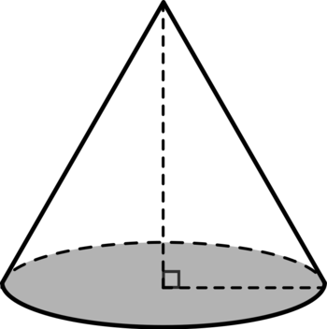
Volume of a Pyramid
cone
The volume of any pyramid can be
calculated using the formula
A = Area of base
h = height

Slide 13
Volume of Pyramid
Q. Find the volume the pyramid.
12m
100m²

Slide 14
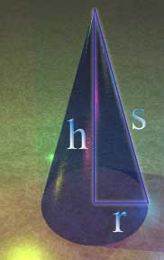
Volume of a Cone
h
r
If the above cone has radius 15cm and height
of 10 cm. Calculate it’s volume.

Slide 16
Now Try
TJ N5 Lifeskills
Ex 19.1
Page 174

Slide 17
Starter Questions
Q1. Find the area of the triangle.
10cm
6cm
Q2. Find $\frac{2}{5}$ of 825
Q3. Calculate

Slide 18
Volume of Solids
Learning Intention
Success Criteria
We are learning how to use the sphere formula and use it to solve real-life problems.
To know the volume formula for a sphere.
Work out volumes for spheres.
Answer to contain
appropriate units and working.

Slide 19
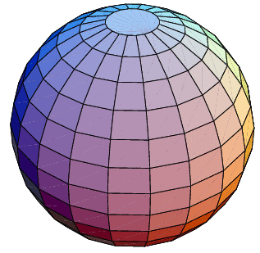
Volume of a Sphere
D = diameter
r
D
Q. If the above sphere has radius 10cm.
Calculate it’s volume.

Slide 20
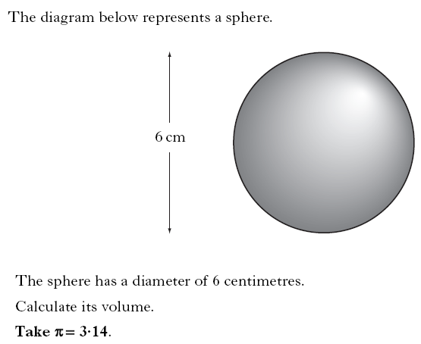

Slide 21
Volume
Now Try
TJ N5 Lifeskills
Ex 19.2
Page 177

Slide 22
Volume of Solids
Learning Intention
Success Criteria
We are learning how to calculate composite volume of complicated shapes.
To know the volume formula for various basic shapes.
Work out volumes for composite shapes.
Answer to contain
appropriate units and working.

Slide 23
Q. Find the volume the composite shape.
Volume = cylinder + hemisphere
cylinder
hemisphere
V = Π r²h
= Π ×4×6
= 75.4
V = $\frac{4}{3}Π r3÷2$
= $\frac{4}{3}Π 23÷2$
= 16.75
h = 6m
r
2m
Total volume = 75.4 + 16.75 = 92.15m³

Slide 24
Volume
Now Try
TJ N5 Lifeskills
Ex 19.3
Page 179

Slide 25
Past Paper Questions

Slide 26
Part b on next slide

Slide 28
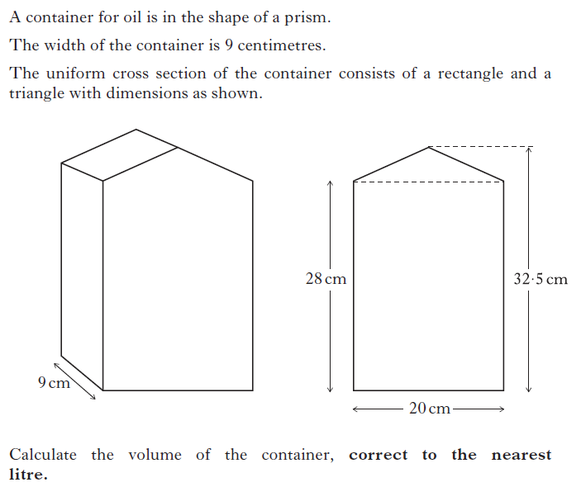

Slide 29
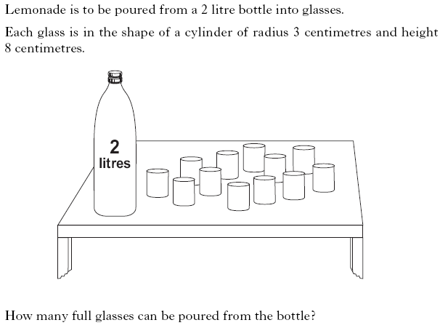

Slide 30
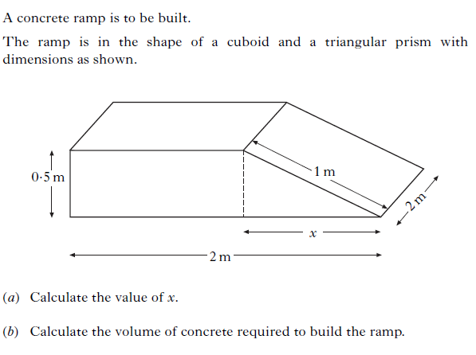

Slide 31
