Slide 1
National 5 Lifeskills Maths
Exchange Rates
Converting between currencies

Slide 2
Exchange Rate Calculations
If you go into a bank or travel agents you will usually see a table of the current exchange rates.
These are often changing and can sometimes change on a daily basis.
Before you exchange money, look around for the best deal.
Look at the tables to find the exchange rate you will need. This will depend on the type of currency you are exchanging.

Slide 3
How to Convert Currency
If you are changing from pounds to a foreign currency
Amount being exchanged(£) x exchange rate
If converting from a foreign currency back into Pounds
Amount in foreign currency ÷ exchange rate

Slide 4
Example
Susan is going on holiday for 1 week to Berlin. She has saved £800 to take with her.
Her local post office has the following exchange rates:
Calculate how much she will receive to spend on holiday.
Currency | Rate
Japanese Yen | 187.46
Euros | 1.37
US Dollars | 1.57
Swedish Krona | 12.90

Slide 5
Exchange rate from table: £1 = 1.37 euros
Euros received = 800 x 1.37 = 1096 euros
While she is away Susan spends on average 90 euros per day. She changes the rest back to pounds. How much in pounds (£) does she have?
Amount spent = 90 x 7 = 630euros
Pounds = (1096-630) ÷ 1.37 =£340.15 (to 2d.p)

Slide 6
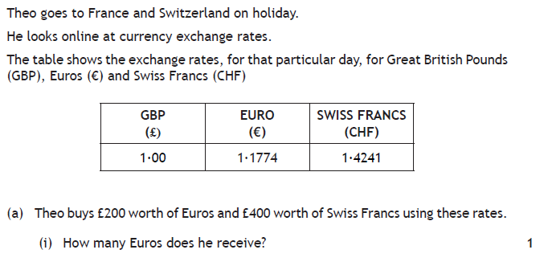
Past Paper Question
Euros = 200 x 1.1774 = 235.48 euros
Swiss= 400 x 1.4241 = 569.64 Swiss francs

Slide 7
400 x 1.1774 = 470.96 Euros
470.96 x 1.2194 =574.29 Swiss francs
6 x 180 =1080 CHF
1080 – 780 = 300 CHF

Slide 8
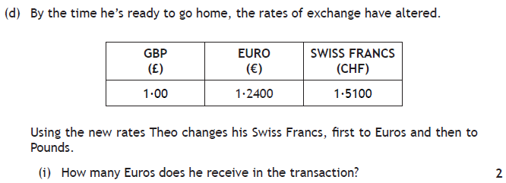
€ : CHF
1.24 : 1.51
1.24 ÷ 1.51 : 1
1.24 ÷ 1.51 x 300 : 300
1.24 ÷ 1.51 x 300 = 246.26 euros

Slide 9
Now complete the worksheet

